Slide 1
Diagnosing Error in Temporal Action Detectors
Humam Alwassel*, Fabian Caba*, Victor Escorcia*, Bernard Ghanem
* Equal contribution

Slide 2
What Can a Single Scalar Metric Tell us?
Relaying on average-mAP to dictate progress does not give us the full picture of the problem
Not much actually!
What makes an algorithm more effective than another?
What makes an action hard to localize?
Is the uncertainty of the temporal boundaries impeding the development of new algorithms?

Slide 3
We Need a Full In-Depth Analysis
We introduce a new diagnostic tool that goes beyond a single scalar metric
Analyzes the false positive error sources and their impact on the performance
Investigates the localization metric sensitivity to different characteristics of the ground truth instances
Inspect the influence of ground truth instance characteristics on the miss detection rate
Notes:
establish a comparison among different methods in tems of action characteristics and error types.

Slide 4
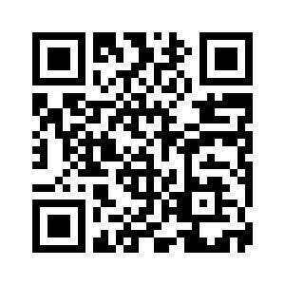
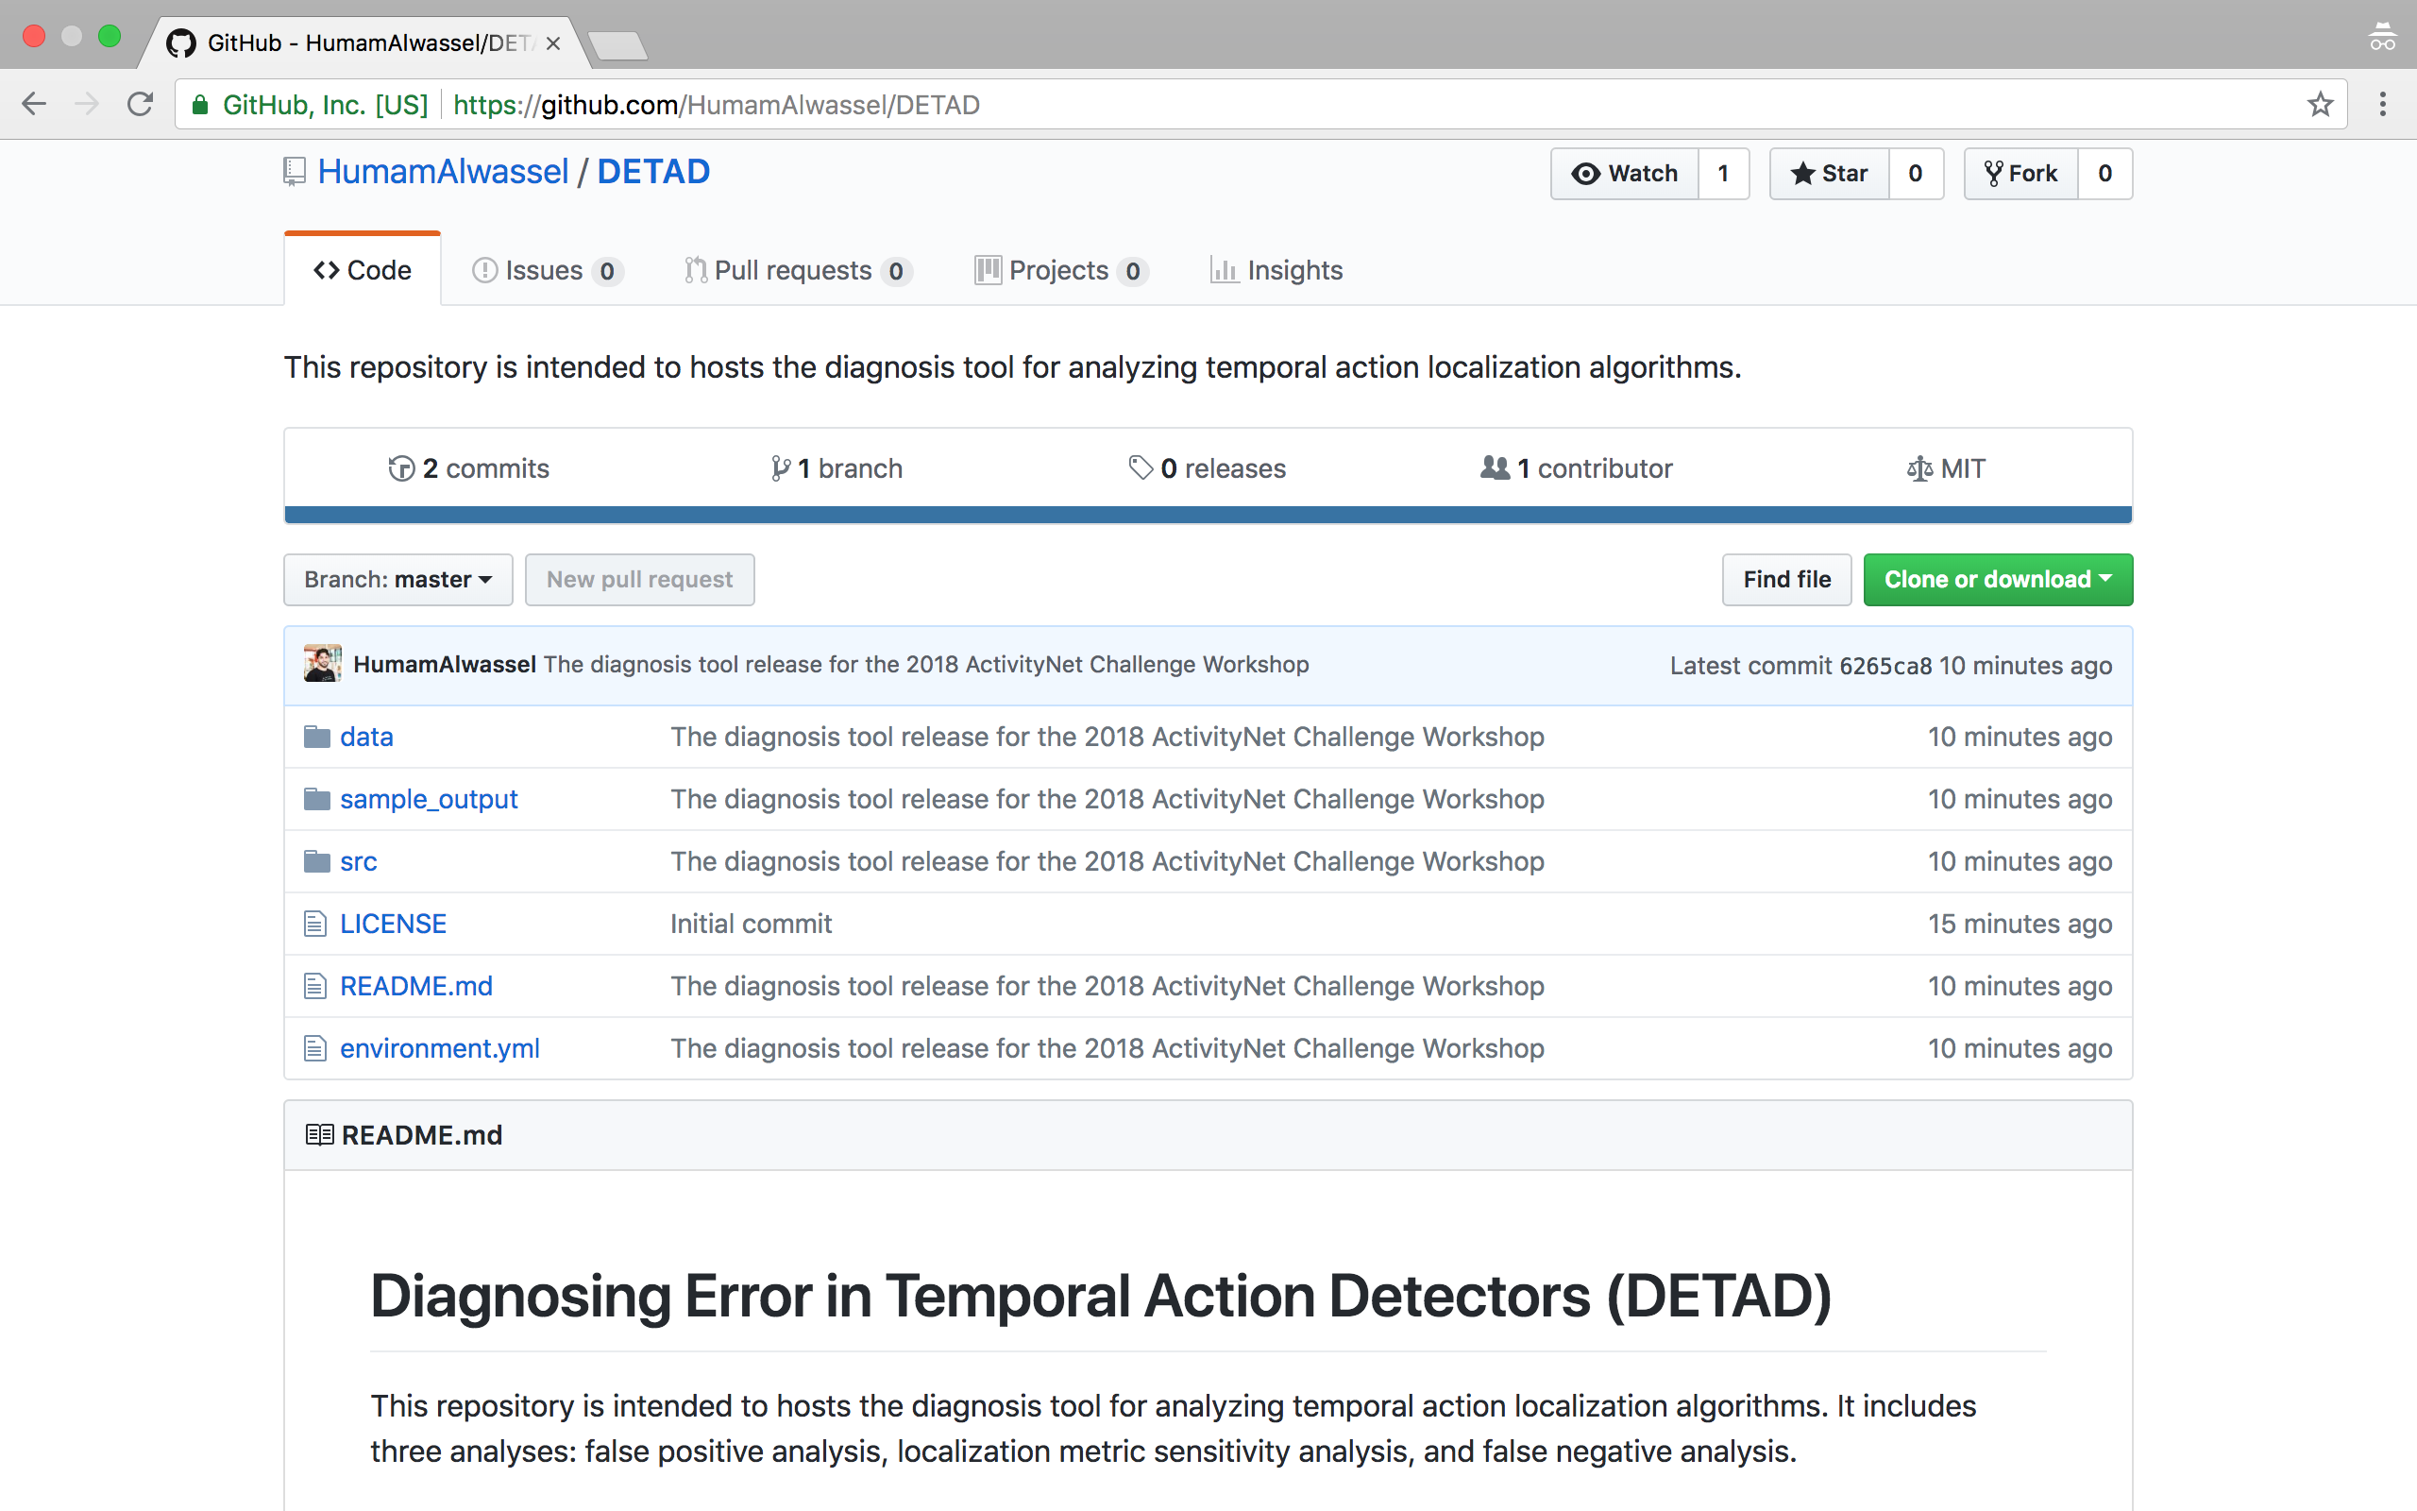
We are Releasing this Tool Today!
URL:
www.github.com/HumamAlwassel/DETAD

Slide 5
Table of Content: - Data Characterization - Categorization of Temporal Localization Errors - False Positive Analysis - Metric Sensitivity Analysis - False Negative Analysis

Slide 6
Table of Content: - Data Characterization - Categorization of Temporal Localization Errors - False Positive Analysis - Metric Sensitivity Analysis - False Negative Analysis

Slide 7
Let’s Play Some Games

Slide 8
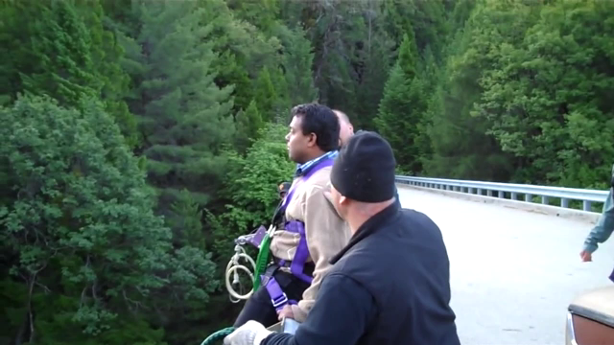
Let’s Play Some Games

Slide 9
Let’s Play Some Games
67% of our labs’ colleagues guessed B

Slide 10
Data Characterization
We annotated ActivityNet v1.3 instances with 6 additional characteristics:
Context Size
How much of the temporal context around the instance can help you guess the action?
Context Distance
What is the furthest distance away from the instance at which you can still guess the action?
Agreement
What is the median tIoU between multiple annotations of the same instance?
Instance Coverage
Instance Length
Number of instances in the same video

Slide 11
Data Characterization
58.4% of instances have more than 3 context glimpses
context glimpse: a 5-second clip from the ±15 seconds around the instance that can help you guess the action label.
83.8% of instances exhibit at least Mid agreement
Mid agreement: the median tIoU among multiple annotators is between (0.4, 0.6]

Slide 12
Table of Content: - Data Characterization - Categorization of Temporal Localization Errors - False Positive Analysis - Metric Sensitivity Analysis - False Negative Analysis

Slide 13
False Positive Error Classification
BG: Background Error; CON: Confusion Error; LOC: Localization Error;
WL: Wrong Label Error; DD: Double Detection Error; TP: True Positive.
tIoU threshold = 0.5

Slide 14
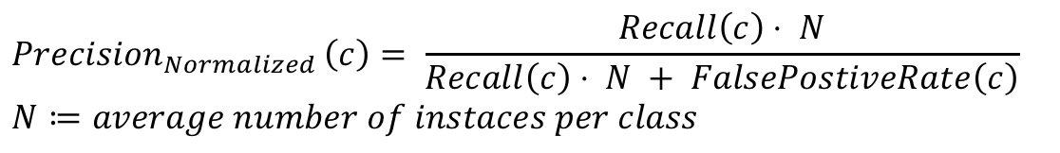
False Positive Profile and Impact
G: the number of ground truth instances
$${Precision}_{Normalized }\left(c\right)= \frac{Recall\left(c\right)⋅ N}{Recall\left(c\right)⋅ N + FalsePostiveRate\left(c\right)}$$
$$N≔average number of instaces per class$$

Slide 15
Table of Content: - Data Characterization - Categorization of Temporal Localization Errors - False Positive Analysis - Metric Sensitivity Analysis - False Negative Analysis

Slide 16
False Positive Profile and Impact
1st Place Team
2nd Place Team
3rd Place Team

Slide 17
Table of Content: - Data Characterization - Categorization of Temporal Localization Errors - False Positive Analysis - Metric Sensitivity Analysis - False Negative Analysis

Slide 18
Temporal Localization Metric Sensitivity
1st Place Team

Slide 19
Temporal Localization Metric Sensitivity
1st Place Team
2nd Place Team
3rd Place Team
The metric performance is most sensitive to Coverage
Context Size and Context Distance have the most impact on the metric performance
Surprisingly, the metric performance is least sensitive to Agreement

Slide 20
Table of Content: - Data Characterization - Categorization of Temporal Localization Errors - False Positive Analysis - Metric Sensitivity Analysis - False Negative Analysis

Slide 21
False Negative Analysis

Slide 22
Conclusion

Slide 23
How can we Improve the Next Generation of Temporal Action Detectors?
False positive analysis
Focus on fixing localization errors
Don’t focus as much on fixing background or wrong label errors
Metric sensitivity analysis
The uncertainty of the temporal boundaries is not impeding the development of better algorithms
Develop algorithms that are less sensitive to Coverage and Context Size
False negative analysis
Instances are harder to detect when there is more relevant temporal context around them (high Context Size)

Slide 24
We are Releasing this Tool Today!
URL:
www.github.com/HumamAlwassel/DETAD

